Slide 1
Modern College of Arts,Science & Commerce
Coffee Shop Management
By-
Name : Ritesh Ramdas Pokharkar
Enrollment No: 2102894

Slide 2
Agenda
System Overview
Technologies Used
Problem definition
Limitation of manual system
Proposed System
Design Specification
Input screen
Features of the System
Limitation
Future Enhancements
Challenges

Slide 3
System Overview
s. Here's a high-level system overview: User Interface (UI): The UI is the front-end of the system accessible to cafe staff for various functions like order taking, menu management, and customer service. It provides an intuitive interface for employees to interact with the system efficiently.
Order Management: This module allows staff to take customer orders, including items, quantity, and special requests. It handles dine-in, takeout, and delivery orders and ensures order accuracy.
Menu Management: Menu management enables cafe owners or managers to add, update, or remove menu tems.It may support categorizing items (e.g., appetizers, main courses, beverages) and defining prices.
Inventory Control: This module keeps track of available ingredients and supplies needed for menu items.

Slide 4
Technologies Used
A Coffee Shop Management System typically involves a combination of hardware and software technologies to efficiently run the operations of a shop. Here are some of the key technologies commonly used in coffee shop management systems:
Point of Sale (POS) System:
Hardware: Touchscreen monitors, barcode scanners, receipt printers, cash drawers, and card readers.
Software: POS software for order taking, payment processing, and inventory management.
Inventory Management Software:
Software: Inventory tracking and management software to monitor stock levels, reorder supplies, and manage ingredient costs.
Customer Relationship Management (CRM) Software:
Software: CRM software for maintaining customer records, loyalty programs, and email marketing.
Reservation and Table Management:
Software: Reservation and table management systems to optimize seating arrangements and track reservations.
Kitchen Display Systems (KDS):
Hardware: Screens or monitors in the kitchen.
Software: KDS software to display orders to kitchen staff, ensuring efficient order preparation.
Online Ordering and Delivery Platforms:
Software: Online ordering and delivery platforms or mobile apps to facilitate online orders and deliveries.
Employee Scheduling and Time Clock Software:
Software: Employee scheduling and time tracking software to manage staff shifts and attendance.

Slide 5
Problem Definition
Problem Statement: Coffee businesses face numerous operational challenges, including order management, menu updates, inventory control, customer management, billing, and more. Manual processes are often error-prone, time-consuming, and inefficient. The coffee shop management system project aims to address these challenges by creating a comprehensive software solution that streamlines cafe operations, enhances customer service, and improves overall efficiency. Key Problem Areas: Order Management: Manually taking and processing customer orders can lead to errors,
delays, and miscommunication between the front-of-house and kitchen staff.
Menu Management: Updating and managing the cafe's menu, including adding new items, changing prices, and ensuring item availability, can be a cumbersome task.
Inventory Control: Tracking inventory levels of ingredients and supplies is challenging, leading to stockouts, overstocking, and food wastage.

Slide 6
Problem Definition (Continued..)
Customer Management: Maintaining customer records, preferences, and loyalty programs manually can be time-consuming and prone to errors.
Billing and Payment: Manual billing processes are slow, and handling various payment methods can be error-prone.
Staff Management: Managing employee schedules, roles, and payroll can be complex and time-consuming without proper software support.

Slide 7
Limitation Of The Manual System

Slide 8
Proposed System
Objective:
Order Management: Streamlining the process of taking and managing customer orders, including options for dine-in, takeout, and delivery.
Menu Management: Efficiently updating and maintaining the cafe's menu, including adding new items, modifying prices, and managing availability.
Inventory Control: Keeping track of inventory levels for ingredients, supplies, and menu items to avoid stockouts and waste.
Customer Management: Maintaining customer records, preferences, and loyalty programs to enhance customer engagement.
Billing and Payment: Automating the billing process, including generating invoices and processing payments through various methods, such as cash, credit cards, and digital wallets.

Slide 9
List of Processes within the System
Order Taking and Entry:
Customers place their orders with servers or through self-service kiosks or mobile apps.
Orders are entered into the Point of Sale (POS) system.
Payment Processing:
Payment for orders is processed through the POS system.
Various payment methods, including cash, credit/debit cards, mobile payments, and gift cards, are accepted.
Kitchen Order Preparation:
Orders are sent to the kitchen display system (KDS).
Kitchen staff prepare and assemble the orders according to the ticket information.
Inventory Management:
Monitoring and managing inventory levels of ingredients, beverages, and other supplies.
Automated alerts for low stock levels and reordering of supplies.
Table Management and Seating:
Managing reservations and walk-in customers.
Assigning tables to customers and ensuring efficient seating.
Customer Service:
Providing attentive service, addressing customer inquiries, and handling special requests.
Offering recommendations and upselling menu items.

Slide 10
Design Specification

Slide 11
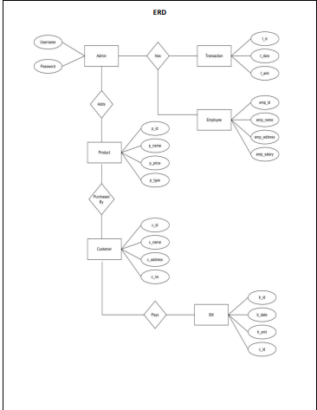
E R Diagram

Slide 12
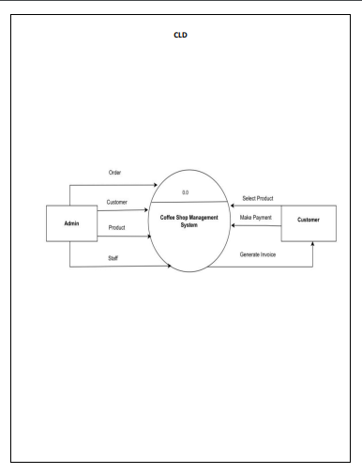
Context level DFD’s

Slide 13
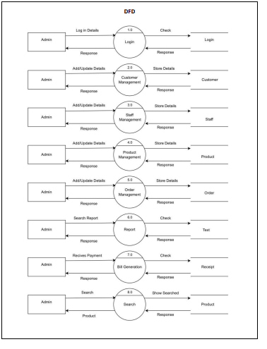
First Level DFD

Slide 14
Features of System
. Here are key features that such a system may have: Order Management: Create, modify, and track customer orders for dine-in, takeout, and delivery. Add items to orders, specify quantity, and accommodate special requests. Real-time order status updates for both staff and customers.
Menu Management: Easily update and manage the cafe's menu, including item names, descriptions, prices, and availability. Categorize items (e.g., appetizers, main courses, beverages) for easy navigation.
Inventory Control: Monitor ingredient and supply levels in real-time. Automated alerts for low inventory levels and reorder management. Track ingredient usage and reduce food wastage.
Customer Management: Create and manage customer profiles with contact information and order history. Implement loyalty programs and discounts based on customer behavior.

Slide 15
Limitation Of the System
Cost of Implementation: Implementing a cafe management system can be expensive. It involves purchasing hardware, software licenses, and ongoing subscription fees. Smaller cafes with limited budgets may find it challenging to invest in such systems.
Learning Curve: Staff members may need time to learn how to use the cafe management system effectively. Training can be time-consuming, and some employees may resist adopting new technology.
Technical Issues: Like any software or hardware, cafe management systems can experience technical glitches, downtime, or compatibility issues. These issues can disrupt daily operations and customer service.
Maintenance and Updates: Regular maintenance and updates are essential to keep the system running smoothly and secure. Neglecting updates can lead to vulnerabilities or software incompatibility.
Data Security: Cafe management systems store sensitive customer and financial data. Ensuring the security of this data is crucial. A data breach could lead to legal issues and damage the cafe's reputation.
Limited Customization: Some cafe management systems may have limited customization options. Cafes with unique requirements may find it challenging to tailor the system to their specific needs.

Slide 16
Future Enhancement
Here are some future enhancement ideas:
Mobile App: Develop a mobile app that allows customers to place orders, make reservations, and receive promotions. Also, provide a mobile app for staff to manage orders and inventory on the go.
Online Ordering: Integrate an online ordering system for both pickup and delivery orders, expanding the cafe's reach to a wider customer base.
Kitchen Display System (KDS): Implement a KDS to improve communication between the front of house and the kitchen, reducing order processing times.
Customer Feedback Portal: Create a customer feedback portal where customers can rate their dining experiences and provide comments, helping the cafe make improvements.
Integration with Delivery Services: Partner with food delivery platforms (e.g., UberEats, DoorDash) for seamless integration and delivery management.

Slide 17
Challenges
Here are some of the key challenges you may encounter: Complexity of Operations:
Cafes have various operations, including order management, menu updates, inventory control, and customer management. Designing a system that handles all these processes seamlessly can be complex. Integration with Hardware:
Integrating the system with POS hardware like cash registers, card readers, and receipt printers can be challenging due to compatibility issues and hardware-specific configurations. User Interface Design:
Creating an intuitive and user-friendly interface for cafe staff is crucial. Designing a UI that simplifies complex tasks can be a challenge. Data Security:
Protecting customer and financial data is essential. Implementing robust security measures to prevent data breaches and unauthorized access is challenging but crucial.

Slide 18
THANK YOU

